Slide 1
Spectroscopy
ULTRAVIOLET-VISIBLE Spectroscopy
Conducto-metry
P^{H} – Metry
IR
NMR

Slide 2
Definitions
Electro-analytical methods are a class of techniques in analytical chemistry, which deals with study of an analyte (test solution) by using suitable instrumental techniques. Eg. pH-Metry, Conductometry etc.
Spectrophotometry is a method to measure intensity of light absorbed by a chemical substance when a beam of light passes through a sample solution.
It is the combination of spectrometry (interaction of electromagnetic radiation of particular wavelength) and photometry (measurement of intensity of transmitted radiation in terms of absorbance). The basic principle is that each compound absorbs or transmits light over a certain range of wavelength.
Spectroscopy is the branch of science that deal with the study of interaction of matter with electromagnetic radiation of particular wavelength and vice-versa

Slide 3
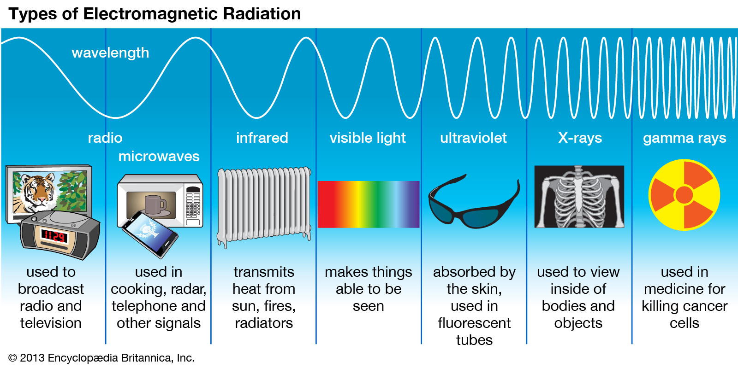
Spectroscopy
Every chemical compound absorbs, transmits, or reflects light (electromagnetic radiation).
Spectroscopy is a measurement of how much a chemical substance absorbs or transmits.
Spectrophotometry is widely used for quantitative analysis in various areas.

Slide 4
LIGHT AND THE PERCEPTION OF COLOR
Light is a form of electromagnetic radiation. When it falls on a substance, certain wavelengths can be absorbed and the remainder transmitted or reflected.
Suppose we shine a beam of white light at a substance that absorbs blue light. Since the blue component of the white light gets absorbed by the substance, the light that is transmitted is mostly yellow, the complementary color of blue.
This yellow light reaches our eyes, and we “see” the substance as a yellow colored substance.
Wavelength (nm) | Color Absorbed | Color Observed
435 | Blue | Yellow
495 | Green | Purple
560 | Yellow | Blue
650 | Orange | Greenish blue

Slide 5
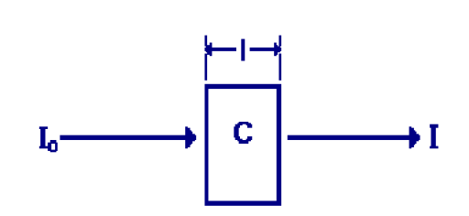
Ultraviolet-Visible Spectroscopy
Introduction to UV-Visible
Absorption spectroscopy from 160 nm to 780 nm
Measurement of transmittance
Measurement of transmittance and absorbance
Conversion to absorbance
A = - log T = ε c l
Beer-Lambert’s law
Noise
Instrumentation

Slide 6
Lambert’s Law
Successive layers of equal thickness of a light absorbing species (solution) absorb equal fractions of the incident radiation
OR
When a monochromatic radiation is passed through a light absorbing species (solution), the decrease in the intensity of radiation with thickness of the a light absorbing species (solution) is directly proportional to the intensity of incident light
OR
Equal fractions of the incident radiation are absorbed by successive layers of equal thickness containing the same number of absorbing species

Slide 7


Derivation of Lambert’s law
The radiation absorbed is directly proportional to the distance covered by the beam.
Mathematically, the law can be expressed as,
Here, dI is the decrease in the intensity of the beam of initial intensity I₀ after passing through the solution of thickness dl.
Negative sign indicates the decrease in the intensity with increase in path length.
After Integration,

Slide 8
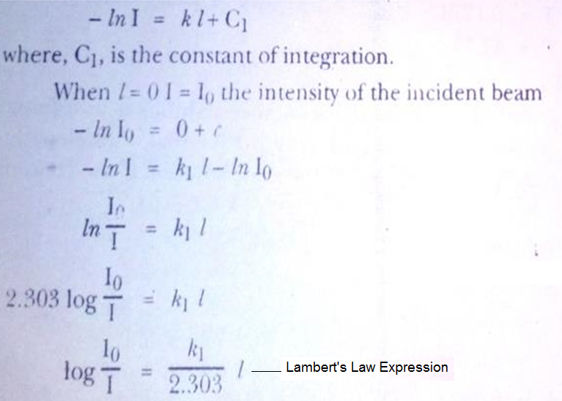

Slide 9


Beer’s Law
Equal changes in concentration of absorbing species in paths of constant length absorb equal fractions of the incident radiation.
OR
Equal fractions of the incident radiation are absorbed by successive layers of the medium containing equal concentration of absorbing species provided the layers have same thickness.
The decrease in the intensity of incident radiation due to absorption is directly proportional to the concentration of absorbing species.
Mathematically,
After integration,

Slide 10
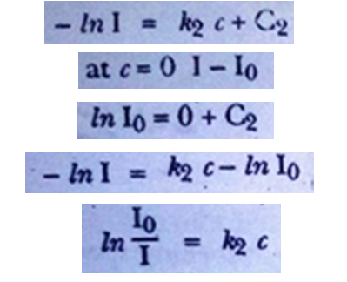

Beer’s Law Expression

Slide 11
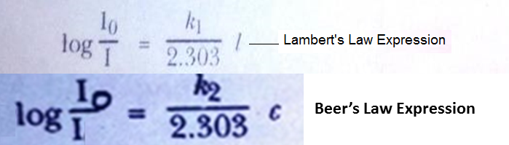
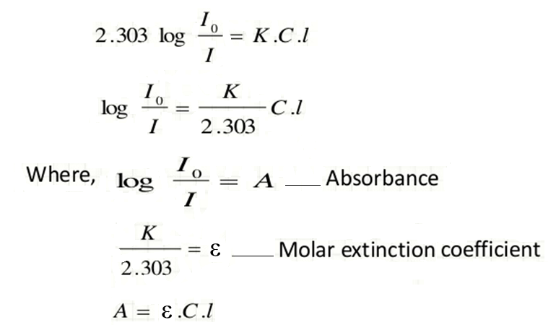
Combining Both Laws we will obtain expression for
Beer-Lambert’s Law

Slide 12
Definitions
Absorbance (A)
It is the logarithm of the ratio of the incident light (I₀) to the transmitted light (I)
It is a unit-less quantity
Molar extinction coefficient or Molar Absorptivity (ε)
It is defined as the absorbance of that solution which has concentration of the absorbing species 1 mol.dm⁻³ and the path length is 1 cm

Slide 13
Formulae for numerical
A = ε . C . l
Where, ε = molar absorptivity, dm³mol⁻¹cm⁻¹
C = concentration, mol.dm⁻³
l = path length, cm
A = 2 – log₁₀ %T
A = -log T = log₁₀ (1/T)

Slide 14
Numerical-1
7.5 x 10⁻⁴ M solution of an absorbing species is placed in a cell of path length 2 cm. Transmittance measured is 60 % at 470 nm. Calculate the molar absorptivity?
Solution:
% T = 60 %
A = 2 – log₁₀ %T = 2 – log₁₀ 60 = 2-1.7782 = 0.2216
A = ε . C . l
Therefore,
Molar absorptivity (ε) = A/ C. l
= 0.2216 / 7.5 x 10⁻⁴ x 2
Molar absorptivity (ε) = 1.477 x 10³ dm³ mol⁻¹ cm⁻¹

Slide 15
Numerical-2
If the transmittance of the solution is 19.4 %, what will be its absorbance ?

Slide 16
Numerical-3
The transmittance of 2 x 10⁻⁴ M solution was found to be 76.2 % in path length of 1 cm. calculate the i) absorbance ii) Molar absorptivity iii) % T for the path length of 2 cm.

Slide 17
Limitations of Beer-Lambert’s Law
The linearity of the Beer-Lambert Law is limited by chemical and instrumental factors
The law does not valid for solutions having concentration greater than 10⁻² M.
Molar extinction coefficient depends on the refractive index of the solution and changes with changes in it.
Interaction with solvent: hydrogen bonding affects ε.
Scattering of light due to particulates in the sample.
Fluorescence or Phosphorescence
- positive deviation in % T and negative deviation for A
Shifts in chemical equilibrium as a function of concentration
Temperature fluctuation and Stray light may affect absorbance measurement

Slide 18
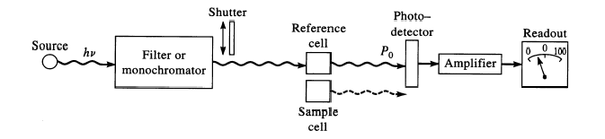
Single beam spectrophotometer

Slide 19
Instrumentation
Light source
Deuterium and hydrogen lamps (190-400 nm)
Tungsten filament lamp (300-750 nm)
Sample containers
Cuvettes (Quartz)
Mono-chromators
Prisms can be used as mono-chromator
Diffraction gratings
Detectors
Photomultiplier tube
Photodiode
Photodiode array

Slide 20
Working of Single beam spectrophotometer
The instrument is useful for both Ultraviolet and Visible regions.
For UV light Deuterium lamps (190-400 nm)
For Visible light Tungsten filament lamp (380-750 nm) are used depending on the requirement.
Light beam is focused on the mono-chromator, where after reflection and dispersion nearly monochromatic beam emerges out.
This emergent monochromatic beam passed through a quartz cuvette containing a sample solution
Transmitted radiation from the cuvette is allowed to fall on a photoelectric cell, which converts radiant energy into electrical signal as absorbance.
Water is generally used as blank solution.

Slide 21
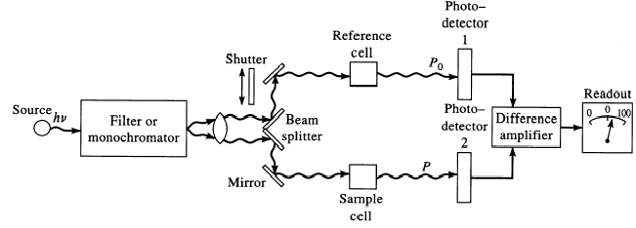
Double beam Spectrophotometer

Slide 22
Instrumentation
Light source
Deuterium and hydrogen lamps (190-400 nm)
Tungsten filament lamp (300-750 nm)
Sample containers
Cuvettes (Quartz)
Beam splitters
- Mirrors
Mono-chromators
Prisms can be used as mono-chromator
Diffraction gratings
Detectors
Photomultiplier tube
Photodiode
Photodiode array

Slide 23
Working of Double beam spectrophotometer
The instrument is useful for both Ultraviolet and Visible regions.
For UV light Deuterium lamps (190-400 nm)
For Visible light Tungsten filament lamp (380-750 nm) are used depending on the requirement.
The variation in the intensity of the source light is compensated by splitting the incident beam into two light beams by passing through beam splitter.
One of the beam passes through the blank solution while other through the sample solution.
Transmitted radiations from the cuvette is allowed to fall on a photoelectric cell, which converts radiant energy into electrical signal as absorbance.
Simultaneously, absorbance of blank and sample solution can be measured.
Water is generally used as blank solution.

Slide 24
Application of UV-Visible Spectroscopy
Quantitative determination of analyte concentration
Identification of inorganic and organic species
Magnitude of molar absorptivity
Used as a detector in HPLC
Used in semiconductor industry to measure thickness and optical properties of thin films.
To study absorbance of organic compounds

Slide 25
CONDUCTOMETRY
CONDUCTOMETRY is based on the principle of determination of change in conductivity of different ions in the solution.
Conductivity of the solution could be changed with the replacement of ions.
Conductance is the flow of electricity through an electrolyte due to migration of ions by applying potential difference between two electrodes.
When the solution contains one single electrolyte, the measured conductance of the solution can be related to concentration of that electrolyte.
It is reciprocal of resistance, [G = 1/R] expressed as Ohm⁻¹ or Siemens

Slide 26
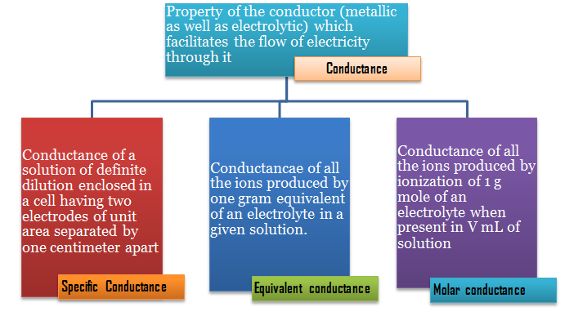
CONDUCTOMETRY

Slide 27
Conductometric Titration
Conductometric titration is a type of titration in which the electrolytic conductivity of the reaction mixture is continuously monitored as one reactant is added to the other.
The equivalence point is the point at which the conductivity undergoes a sudden change.
Marked increase or decrease in conductance is associated with the changing concentrations of the two most highly conducting ions, viz. the hydrogen and hydroxyl ions.
The method can be used for titrating colored solutions or homogeneous suspension

Slide 28
Principle
When solution of one electrolyte is added to another electrolyte, the conductance of the solution will alter, if an ionic reaction occurs.
If no ionic reaction takes place then the conductance of the solution will simply increase.
If an ionic reaction occurs, the ion added may replace another ion and hence bring about change in the conductance.
Let A⁺B⁻ be the ions of titrand and C⁺D⁻ be ions of the titrant, the ionic reaction in the titration is combination of A⁺ and D⁻, AD formed may be insoluble or weakly ionized.
A⁺B⁻ + C⁺D⁻ → AD + C⁺B⁻

Slide 29
Principle
Thus as the titration proceeds, A⁺ are replaced by C⁺. The conductance of the solution increases or decreases depending on whether conductance of C⁺ is greater than or less than that of A⁺. After equivalence point the ionic reaction does not occur and hence, the conductance of the solution will raise due the excess addition of titrant C⁺D⁻.
The principle of conductometric titration is changes in the conductance of the solution due to difference in the ionic conductance or due to production of more number of ions in the solution.

Slide 30
Procedure
A definite volume of the solution to be estimated is pipetted out in a beaker.
A dip type conductivity cell is placed in a beaker. Addition of distilled water may be necessary if the cell does not dip completely in the solution.
The cell is connected to a conductometer and the conductance of the solution is measured. The titrant is filled in the burrete.
The titrant is added in the small portions, generally 0.5 mL at a time. The solution is stirred after each addition.
The solution is allowed to stand for a minute or two after stirring before conductance is measured.
Addition of titrant is continued till about seven to eight readings beyond the equivalence point are obtained.
The plot of conductance against volume of the titrant added is used to locate the equivalence point.

Slide 31
Some Conductometric Titrations
Strong Acid with a Strong Base, [HCl Vs NaOH]
Weak Acid with a Strong Base, [CH₃COOH Vs NaOH]
Strong Acid with a Weak Base, [H₂SO₄ Vs dil. NH₄OH]
Weak Acid with a Weak Base, [CH₃COOH Vs dil. NH₄OH]
Mixture of a Strong Acid (H₂SO₄) and a Weak Acid (CH₃COOH) vs. a Strong Base (NaOH) or a Weak Base (dil. NH₄OH)

Slide 32
Strong Acid with a Strong Base [HCl with NaOH]
Before NaOH is added, the conductance is high due to the presence of highly mobile hydrogen ions. When the base is added, the conductance falls due to the replacement of hydrogen ions by the added cation as H⁺ ions react with OH⁻ ions to form undissociated water. This decrease in the conductance continues till the equivalence point. At the equivalence point, the solution contains only NaCl. After the equivalence point, the conductance increases due to the large conductivity of OH⁻ ions

Slide 33
Weak Acid with a Strong Base [CH₃COOH with NaOH]
Initially the conductance is low due to the feeble ionization of acetic acid. On the addition of base, there is decrease in conductance not only due to the replacement of H⁺ by Na⁺ but also suppresses the dissociation of acetic acid due to common ion acetate. But very soon, the conductance increases on adding NaOH as NaOH neutralizes the un-dissociated CH₃COOH to CH₃COONa which is the strong electrolyte. This increase in conductance continues raise up to the equivalence point. The graph near the equivalence point is curved due the hydrolysis of salt CH₃COONa. Beyond the equivalence point, conductance increases more rapidly with the addition of NaOH due to the highly conducting OH⁻ ions.

Slide 34
Strong Acid with a Weak Base [H₂SO₄ with NH₄OH]
Initially the conductance is high and then it decreases due to the replacement of H⁺. But after the endpoint has been reached the graph becomes almost horizontal, since the excess aqueous ammonia is not appreciably ionised in the presence of ammonium sulphate.

Slide 35
Weak Acid with a Weak Base [CH₃COOH with NH₄OH]
The nature of curve before the equivalence point is similar to the curve obtained by titrating weak acid against strong base. After the equivalence point, conductance virtually remains same as the weak base which is being added is feebly ionized and, therefore, is not much conducting.

Slide 36
Mixture of Strong Acid and Weak Acid vs. Strong Base or Weak Base
In this curve there are two break points. The first break point corresponds to the neutralization of strong acid. When the strong acid has been completely neutralized only then the weak acid starts neutralizing. The second break point corresponds to the neutralization of weak acid and after that the conductance increases due to the excess of OH−ions in case of a strong base as the titrant. However, when the titrant is a weak base, it remains almost constant after the end point similar to Fig

Slide 37
Advantages of Conductometric titrations
Conductometric titration are found to possess several advantages over normal titrimetry namely,
Coloured solutions can be titrated.
The method works equally well for dilute solutions also, as it is based on the changes in the conductance, rather than the absolute value of the conductance.
In conductometric titrations, it is not necessary to make observations around the equivalence point, with small increments of the titrant added.
The observations, far away from the equivalence point, on either side are of importance.
An extremely weak acid or a weak base can be titrated conductometrically, which may not be possible in normal titrimetry.
A mixture of weak and strong acids, can also be titrated with relative ease. Thus, making the simultaneous determination possible.

Slide 38
Limitations
In dilute solutions, obtuse curves are obtained. With obtuse curves it is difficult to locate the equivalence point accurately.
The overall accuracy of the conductometric titrations is limited as the technique does not permit addition of small increments of the titrant.

Slide 39
P^{H} Metry

Slide 40
Definition of pH is an abbreviation of “pondus hydrogenii” and was proposed by the Danish scientist S.P.L. Sørensen in 1909 in order to express the very small concentrations of hydrogen ions.
pH is defined as the negative base 10 logarithm of the hydrogen ion concentration.
pH = - log₁₀[H⁺]
This definition is closely related to the operational pH definition which is currently defined using a standardised hydrogen electrode setup and buffers standardised in accordance with IUPAC recommendations.

Slide 41
pH is measured using a setup with two electrodes: the indicator electrode and the reference electrode.
These two electrodes are often combined into one - a combined electrode.
When the two electrodes are immersed in a solution, a small galvanic cell is established. The potential developed is dependent on both electrodes. Ideal measuring conditions exist when only the potential of the indicator electrode changes in response to varying pH, while the potential of the reference electrode remains constant.
E = E _{ind} – E _{ref}
E = Eº – (RT/nF) ln[conc.]

Slide 42
A reference electrode is an electrode which has a stable and well-known electrode potential
Saturated calomel electrode Construction:
It consists of a tube at the bottom of which a small mercury drop is placed. It is covered with a paste of solid Hg₂Cl₂. The aqueous phase in contact with the mercury and the mercury (I) chloride (Hg₂Cl₂, "calomel") is a saturated solution of potassium chloride in water. The electrode is normally linked via a porous frit to the solution in which the other electrode is immersed. This porous frit is a salt bridge.
In cell notation the electrode is written as:

Slide 43
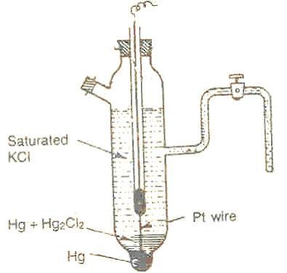
Working:
The electrode reaction when the cell acts as cathode is
½ Hg₂Cl₂(s) + e⁻ → Hg + Cl⁻
E = Eº _{Cl-|Hg2Cl2|Pt} – RT/F ln a_{Cl-}
Advantages:
It is simple to construct
Results of cell potential measurements are reproducible
Stable over a long period

Slide 44
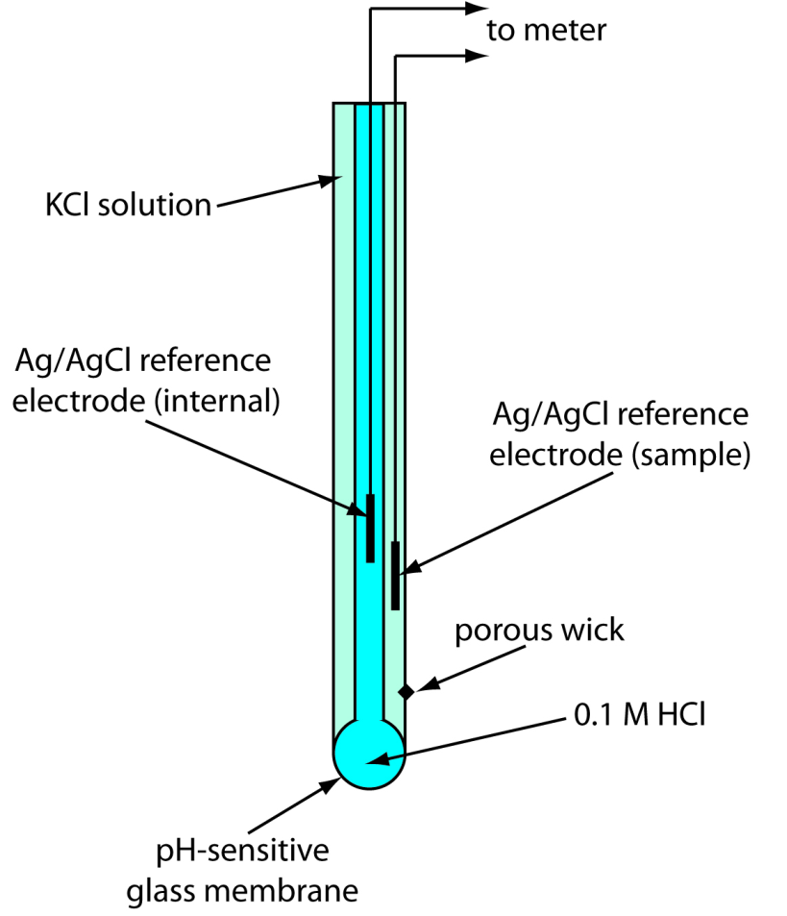
Ion Selective electrode
A glass electrode is a type of ion-selective electrode made of a doped
glass membrane that is sensitive to a specific ion.
Construction:
It consists of glass membrane, it separates an internal solution and silver /
silver chloride electrode from the studied solution
Ag|AgCl|HCl|glass||probed solution|reference electrode

Slide 45

Applications:
Glass electrodes are commonly used for pH measurements. There are also specialized ion sensitive glass electrodes used for determination of concentration of lithium, sodium, ammonium, and other ions. Glass electrodes have been utilized in a wide range of applications — from pure research, control of industrial processes, to analyze foods, cosmetics and comparison of indicators of the environment and environmental regulations: a microelectrode measurements of membrane electrical potential of a biological cell, analysis of soil acidity, etc.

Slide 46
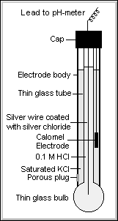
Combination electrode
Construction: The fig. shows the internal components of the pH electrode. The heart of the electrode is a thin bulb of pH-sensitive glass, which is blown onto the end of a length of glass tubing. The pH-sensitive glass (glass membrane) is sealed to the electrode and contains a solution of potassium chloride at pH 7. A silver wire plated with silver chloride contacts the solution. The Ag/AgCl combination in contact with the filling solution sets an internal reference potential. This potential depends on the chloride concentration in the filling solution and as long as this electrolyte concentration is maintained, the electrode potential is constant.

Slide 47
Working: The outside surface of the glass membrane is in contact with sample being measured and the inside surface contacts the filling solution. A complex mechanism at each glass liquid interface defines the potential the pH glass electrode, while the inner pH glass/ filling solution potential is constant, the outside potential varies based on the H⁺ ions concentration in sample. This equilibrium depends also on temperature.

Slide 48
How to measure the pH of solution: Measurement of pH:
A pH measurement system consists of a pH probe, reference probe, temperature sensor, pH meter and the sample to be measured. In most cases the three probes are combined in one electrode. When the pH probe is in contact with a solution a potential forms between the pH probe and the reference probe. The meter measures the potential and converts it, using the calibration curve parameters, into a pH value.
A typical combination glass electrode is represented as
In order to measure the pH of a sample first the standardization of pH meter is required to be done before analyzing the sample.
a) Standardization of pH meter:
A two point standardization method is used to standardize the pH meter, it involves immersing the pH assembly i.e. glass electrode into a standard reference pH buffer (pH =4.0) and recording the reading, if the meter reading is more or less than the expected value (4.0) then it is adjusted to pH 4.0 using a crew nob.

Slide 49
Standardization at only one pH value does not assure the validity of reading at other pH values considerably. Hence a second standard reference buffer pH = 9.2 is used. The pH meter reading is recorded using this second buffer solution and the reading is adjusted to pH 9.2 using a crew nob.
During both the steps, the glass electrode is rinsed with distilled water. Immerse the glass electrode previously in water for several hours. Start the measurement more than 5 minutes after switching on. Rinse well the detecting unit with water, and blot the water gently with a piece of filter paper very time.
b) To measure pH of solution:
Wash well the detecting unit with water, and blot the water gently with a piece of filter paper. Place glass electrode in solution you wish to measure pH. Be sure that it is stirring slowly during measure and pH adjustment and take readings.
c) Precautions:
When analysis is complete, put pH meter in stand-by mode. Remove electrode from solution and rinse thoroughly with water. Blot dry and put back in yellow pH storage buffer. Place parafilm over the hole and around the bottle to minimize evaporation.

Slide 50
IR spectroscopy
Near IR 15000 cm⁻¹ to 3000 cm⁻¹
Mid IR 4000 cm⁻¹ to 400 cm⁻¹
Far IR 200 cm⁻¹ to 10 cm⁻¹
Most used 4000 cm⁻¹ to 670 cm⁻¹
Infrared radiation is largely thermal energy. It induces stronger molecular vibrations in covalent bonds, which can be viewed as springs holding together two masses, or atoms.
Specific bonds respond to (absorb) specific frequencies.

Slide 51
Fundamental Modes of Vibration
A molecular vibration is a periodic motion of the atoms of a molecule relative to each other, such that the center of mass of the molecule remains unchanged.
The typical vibrational frequencies, range from less than 10¹³ Hz to approximately 10¹⁴ Hz, corresponding to wavenumbers of approximately 300 to 3000 cm⁻¹.
In general, a non-linear molecule with N atoms has (3N – 6) normal modes of vibration, but a linear molecule has (3N – 5) modes, because rotation about the molecular axis cannot be observed.
A diatomic molecule has one normal mode of vibration, since it can only stretch or compress the single bond.
Vibrations of polyatomic molecules are described in terms of normal modes, which are independent of each other, but each normal mode involves simultaneous vibrations of different parts of the molecule.

Slide 52
VIBRATIONAL MODES
Stretching : in which the distance between the two atoms increases or decreases but the atoms remain in the same bond axis.
Bending: in which the position of the atom changes relative to the bond axis. Covalent bonds can vibrate in several modes, including stretching, rocking, and scissoring.

Slide 54
Which substances give a signal in IR spectrum?
Ans:
The molecules that contain polar bonds i.e. molecules composed of atoms of different elements, organic compounds and inorganic compounds (H₂O, CO₂, NO₂, HCl, salts...) can give a signal in IR spectrum.
Whereas pure chemical elements in molecular or crystal state e.g. Ar, O₂, O₃, N₂, Cl₂, S₈, silicon, graphite, Diamond etc. cannot give a signal in IR spectrum.

Slide 55
AN IR SPECTRUM IN ABSORPTION MODE

Slide 56
CLASSIFICATION OF IR BANDS

Slide 57
INFORMATION OBTAINED FROM IR SPECTRA
IR is most useful in providing information about the presence or absence of specific functional groups.
IR can provide a molecular fingerprint that can be used when comparing samples. If two pure samples display the same IR spectrum it can be argued that they are the same compound.
IR does not provide detailed information or proof of molecular formula or structure. It provides information on molecular fragments, specifically functional groups.
Therefore it is very limited in scope, and must be used in conjunction with other techniques to provide a more complete picture of the molecular structure.

Slide 58
FINGERPRINT REGION
Although the entire IR spectrum can be used as a fingerprint for the purposes of comparing molecules, the 600 - 1400 cm⁻¹ range is called the fingerprint region.
This is normally a complex area showing many bands, frequently overlapping each other.

Slide 59
Functional Groups AND IR Frequencies
Characteristic IR Absorption Frequencies of Organic Functional Groups
Functional Group | Type of Vibration | Characteristic Absorptions (cm⁻¹) | Intensity
Alcohol
O-H | (stretch, H-bonded) | 3200-3600 | strong, broad
O-H | (stretch, free) | 3500-3700 | strong, sharp
C-O | (stretch) | 1050-1150 | strong
Alkane
C-H | stretch | 2850-3000 | strong
-C-H | bending | 1350-1480 | variable
Alkene
=C-H | stretch | 3010-3100 | medium
=C-H | bending | 675-1000 | strong
C=C | stretch | 1620-1680 | variable

Slide 60
Alkyl Halide
C-F | stretch | 1000-1400 | strong
C-Cl | stretch | 600-800 | strong
C-Br | stretch | 500-600 | strong
C-I | stretch | 500 | strong
Alkyne
C-H | stretch | 3300 | strong,sharp
 | stretch | 2100-2260 | variable, not present in symmetrical alkynes
Amine
N-H | stretch | 3300-3500 | medium (primary amines have two bands; secondary have one band, often very weak)
C-N | stretch | 1080-1360 | medium-weak
N-H | bending | 1600 | medium

Slide 61
Aromatic
C-H | stretch | 3000-3100 | medium
C=C | stretch | 1400-1600 | medium-weak, multiple bands
Analysis of C-H out-of-plane bending can often distinguish substitution patterns
Carbonyl | Detailed Information on Carbonyl IR
C=O | stretch | 1670-1820 | strong
(conjugation moves absorptions to lower wave numbers)
Ether
C-O | stretch | 1000-1300 (1070-1150) | strong
Nitrile
CN | stretch | 2210-2260 | medium
Nitro
N-O | stretch | 1515-1560 & 1345-1385 | strong, two bands

Slide 62
How to Analyse the IR spectrum?
When analysing the IR spectrum of an unknown molecule, first efforts on determining the presence or absence of a few major functional groups.
The C=O, O-H, N-H, C-O, C=C, -CN, and NO₂ peaks.
These peaks are most likely to give immediate structural information if they are present.
Do not try to make a detailed analysis of the C-H absorption near 3000 cm⁻¹, almost all the compounds have these absorptions.

Slide 63
Follow these steps
1) If carbonyl group is present ? The –C=O group give rise to a strong absorption in the region 1820-1660cm⁻¹ . The peak is often strongest in the spectrum and of medium width.
2) If C=O is present, then check the following types
Acids | Is O-H also present? Broad absorption near 3400-2400cm⁻¹ usually overlaps with C-H
Amides | Is N-H also present? Medium absorption near 3400cm⁻¹, sometimes double peaks with same size.
Esters | Is C-O present? Strong intensity absorption near 1300-1000cm⁻¹
Anhydrides | Two C=O absorption near 1810 and 1760cm⁻¹
Aldehydes | Is aldehyde C-H present? Two weak absorption near 2850 and 2750 cm⁻¹
Ketones | The preceding five choices have been eliminated

Slide 64
3) If C=O absent, then check the following options
4) Double bonds and/or aromatic rings
Alcohols, Phenols | Check for O-H, broad absorption near 3400-3300cm⁻¹, confirm this by finding C-O near 1300-1000cm⁻¹
Amines | Check for N-H, Medium absorptions near 3400cm⁻¹
Ethers | Check for C-O near 1300-1000cm⁻¹ and absence of O-H near 3400cm⁻¹
C=C is weak absorption near 1650cm⁻¹
2. Medium strong absorption in the region 1600-1450cm⁻¹, these often imply on aromatic ring
3. Confirm the double bond or aromatic ring by consulting the C-H region; aromatic and vinyl C-H occurs to left of 3000cm⁻¹, aliphatic C-H occurs to right of this value.

Slide 65
4) Triple bonds
5) Nitro groups
Two strong absorption at 1600-1530cm⁻¹ and 1390-1300cm⁻¹
6) Hydrocarbons
1) C=N is medium sharp absorption near 2250cm⁻¹
2) C=C is e weak, sharp absorption near 2150cm⁻¹
3) Check also for acetylenic C-H near 3300cm⁻¹
None of the preceding found.
Major absorptions are in C-H region near 3000 cm⁻¹
Very simple structure the only another absorption appear near 1460 and 1375 cm⁻¹

